Slide 1
Maven
By Adam

Slide 2
Why xml?
XMLdefines a set of rules for encoding documents in a format that is both human readable and machine readable.
It is defined by the W3C's XML 1.0 Specification and by several other related specifications, all of which are free open source.
XML has come into common use for the interchange of data over the Internet.
Lots of framework use xml file has configuration

Slide 3
What is XML?
XML stands for EXtensible Markup Language
XML is a markup language much like HTML.
XML was designed to describe data.
XML tags are not predefined in XML. You must define your own tags.
XML is self describing.
XML uses a DTD (Document Type Definition) to formally describe the data.

Slide 4
Outline
Introduce Maven
Basic Maven Pom File and Project Structure
Dependencies

Slide 5
Maven
Maven is a simple build automation tool which is basically used with java projects.
Maven also ease up the task of developers in checking a build status, generating reports (basically javadocs) and setting up the automated build process and monitor the same.
Maven aims to describe 2 important things :
How a software is built.
The dependencies, plug-ins & profiles that the project is associated in a standalone or a distributed environment.

Slide 6
Maven Features
Simple project setup that follows best practices.
Consistent usage across all projects.
Dependency management including automatic updating.
A large and growing repository of libraries.
Model-based builds: Maven is able to build any number of projects into predefined output types such as jar, war, metadata

Slide 7
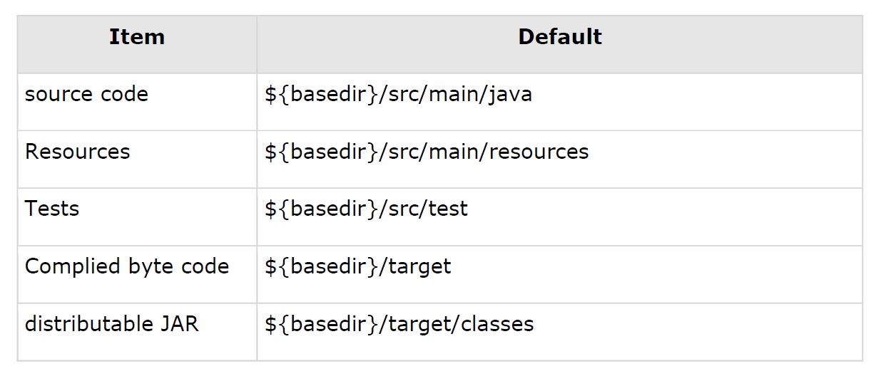
Maven project Str..
As an example, following table shows the default values for project source code
files, resource files and other configurations. Assuming, ${basedir} denotes the
project location:

Slide 8
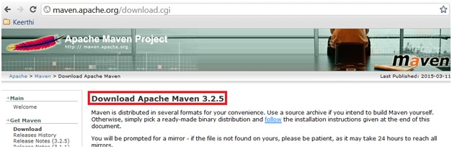
Setting up Maven Environment
STEP 1
Download the latest version of the maven from http://maven.apache.org website.

Slide 9
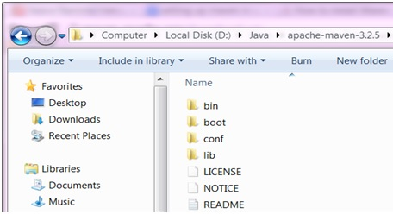
STEP 2
Once the download is successful. Unzip the downloaded maven zip and place it in a drive containing all the java related artifacts. E.g. D:\Java\apache-maven-3.2.5 , in case you have downloaded any other latest release than the version may differ, but thats not a problem.

Slide 10
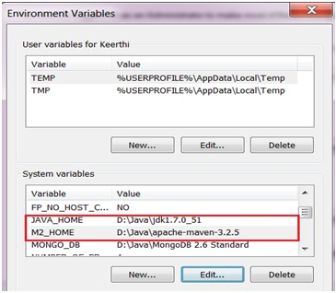
STEP 3
Now we need to set up the class path Java (JAVA_HOME) and Maven (M2_HOME). If you already have JAVA_HOME set, then you only need to set M2_HOME for Maven. Kindly ensure that the required version of the jdk has been installed.

Slide 11
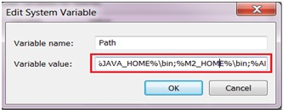
Now edit the variable Path in the System variables to include the JAVA_HOME and M2_HOME.

Slide 12
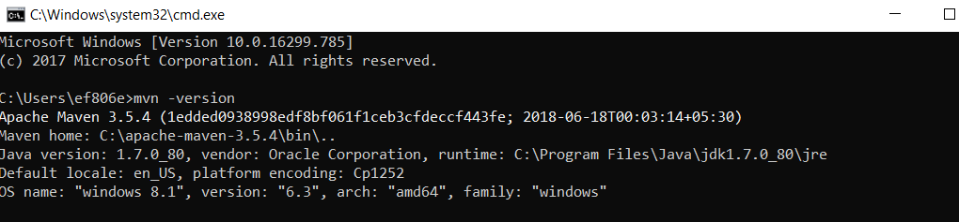
STEP 4
Just open up the command prompt from the Start -> Command Prompt
and in the command prompt just type the maven command
mvn -version and press enter.

Slide 13
What is POM?
The easiest way to describe a POM in a maven project is, it is nothing but the core element of any maven project. Basically any maven project consists of one configurable file called pom.xml, which stands for the abbreviation Project Object Mode.
The pom.xml basically contains the information related to the project which is built or to be built in. It contains all the necessary information about the configuration details, dependencies included and plug-ins included in the project.

Slide 14
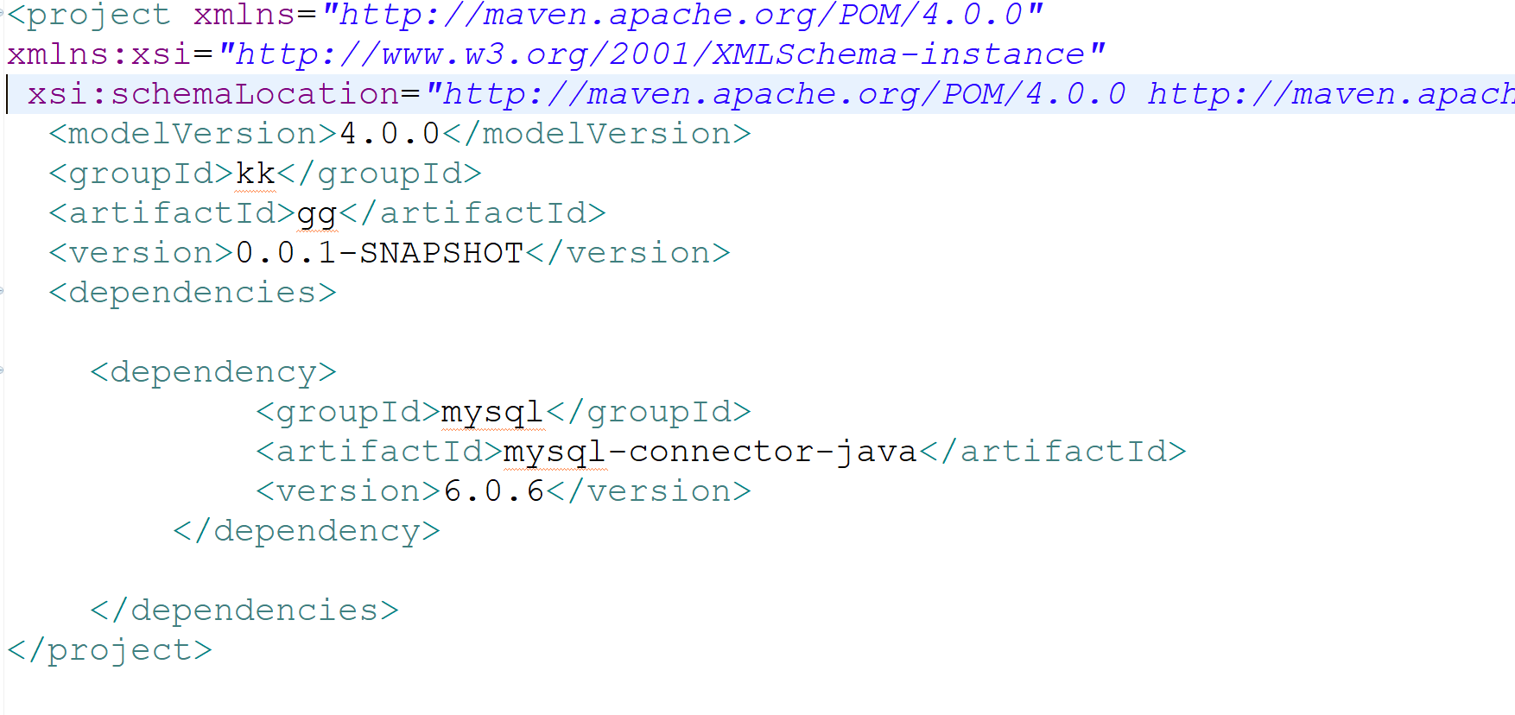
A typical pom.xml of simple java project will look like as shown in the below figure.

Slide 15
Pom.xml
A pom.xml will always start with the root element called
<project> under which all the other required configurations will be made.
Developers should ensure to define the below list of elements which are known as
maven co-ordinates before defining a pom.xml file :
groupId - as the name itself shows that this is an id which is unique for
any project in an organization.
artifactId - Even though the name says as "id", this is
basically defines the name of any project.
version - This element is used to derive the version of any
project

Slide 16
Goals in Maven
Goal in maven is nothing but a particular task which leads to the compiling, building and managing of a project. A goal in maven can be associated to zero or more build phases.

Slide 17
What is Repositories in Maven?
For maven to download the required artifacts of the build and dependencies (jar files) and other plugins which are configured as part of any project, there should be a common place where all such artifacts are placed. This common shared area is called as Repository in maven.
In maven, repositories are classified into 3 main categories as shown below :
Local Repository
Remote Repository
Central Repository

Slide 18
Maven Build Life Cycle
What is build life cycle? The sequence of steps which is defined in order to execute the tasks and goals of any maven project is known as build life cycle in maven.
Maven comes with 3 built-in build life cycles as shown below
Clean - this phase involves cleaning of the project (for a fresh build & deployment)
Default - this phase handles the complete deployment of the project
Site - this phase handles the generating the java documentation of the project.

Slide 19
git
What is a version control system?
A version control system (VCS) allows you to track the history of a collection of files. It supports creating different versions of this collection.
These versions are stored in a specific place, typically called a repository.

Slide 20
What is Git?
Git is currently the most popular implementation of a distributed version control system.
Git originates from the Linux kernel development and was founded in 2005 by Linus Torvalds. Nowadays it is used by many popular open source projects

Slide 21
Operations & Commands
Some of the basic operations in Git are:
Initialize
Add
Commit
Pull
Push
Some advanced Git operations are:
Branching
Merging
Rebasing

Slide 22
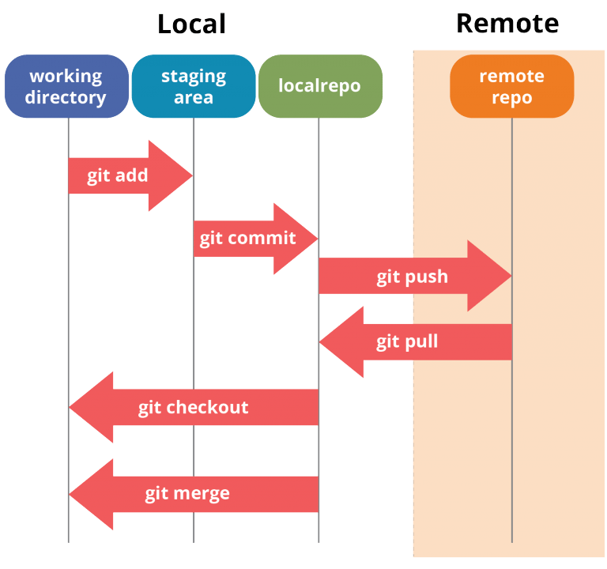
Architecture of Git below:

